Slide 1
RMHS
Board of Directors
March 17, 2021

Slide 2
Welcome and Introductions

Slide 3
Consent agenda
• Approval of March 17, 2021 Agenda
• Adoption of January 20, 2021 Board Minutes
Proposed Board Resolution: The Board accepts the items on the Consent Agenda.

Slide 4
Mission report
Denver Early Steps -- Hayley Carle

Slide 5

Denver Early Steps

Slide 6
Background Information
Early Intervention Colorado
(EI Colorado)
  Program through the State of Colorado that provides funding towards clinical therapy services for children with developmental delays in at least one developmental area
  Supports children with developmental needs
  25% and greater delay in at least one area of development eligibility
COVID-19 Pandemic Changes
  Funding changes at the State of Colorado (July 2020)
  New legislation requires a 33% and greater delay in at least one area of developmental eligibility

Slide 7


Slide 8
Denver Early Steps
Eligibility Requirement Changes
  27% of RMHS Early Intervention clients would be ineligible for therapy services based on the new State of Colorado requirements
Denver Early Steps (DES) created through RMHS
  DES was created to ensure therapy services would be provided to City and County of Denver residents who would become ineligible according to the new State of Colorado requirements
  DES serves clients with developmental delays in at least one developmental area with a delay between 25% to 33%
  All of this is possible due to Mill Levy Funding

Slide 9


Slide 10
Similarities
DES will continue the parent coaching model
DES will continue to provide trans-disciplinary teaming attentive to our client’s needs
DES will continue to provide access to services at the frequency that best meets the child and family’s needs as well as the provider’s recommendations
DES will continue to approach and create service plans that are based on the children’s strengths and the family’s routine
DES will continue to utilize the Primary Service Provider (PSP) model
DES will continue to provide services within the child’s natural environment
DES will continue to hold transition meetings with Denver Public Schools based on if the child would be a good fit for an IEP (Individualized Education Plan)

Slide 11


Slide 12
Differences
DES will pair children eligible for the program with providers prior to their first meeting
A DES provider, at their first meeting, will complete a discipline specific evaluation for the child to develop the best course of action to support the child and family’s needs
A DES provider, upon completion of the first meeting, will contact the service coordinator to schedule the service plan meeting which will take place during the family’s regularly scheduled therapy appointment
The DES providers and service coordinators will communicate at least once a month to ensure the team is updated with current information as well as how to best support the family and find solutions for any needed resources

Slide 13


Slide 14
Transition into Other RMHS Programs
Denver Early Steps → Early Intervention
  If a child in the DES program becomes eligible for EI services at any point the provider and the service coordinator will work together with the family to transfer them into the Early Intervention program
Denver Early Steps → Single Entry Point
  Dependent on the needs of the child, a child in the DES program could be eligible to move into the Single Entry Point program
Denver Early Steps → Family Support
  Dependent on the needs of the child, a child in the DES program could be eligible to move into the Family Support program

Slide 15

Questions?

Slide 16
President’s report
• Executive Committee Report
• Governance Committee Report
* Discussion of future board membership
* Nomination of new board member
Proposed resolution
The board elects Stewart Tucker Lundy as a member of the RMHS Board of Directors for a three-year term beginning April 1, 2021 and ending March 31, 2024.

Slide 17
Public comment 7 p.m.

Slide 18
Executive Director’s report
* Motion to authorize RMHS’ Executive Director, Chief Financial Officer, and Chief Human Resources Officer to execute contract on behalf of RMHS
* Diversity, Equity and Inclusion Manager

Slide 19


Our Diversity, Equity and Inclusion Journey
What we’ve done:
In January, we updated the board on the months of assessment work that the organization had engaged in
Work we’ve done with our DEI consultant:
  13 two-hour trainings for all staff, 6 BIPOC conversation groups, and the formation of the employee Diversity, Equity and Inclusion Advisory Council
Began recruiting for full-time DEI manager

Slide 20
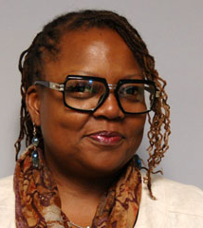
DEI Manager
Adija Diamant
Adija has been a Service Coordinator with RMHS since 2017
She is a graduate of University of Colorado Boulder
Her professional career has focused on human services and teaching
She has taught speech, drama and language arts to special needs students in high poverty schools in south-central Los Angeles
At RMHS, she taught Workplace Fundamentals courses to TANF recipients
Adija is passionate about theater, and the people she has supported in her various roles

Slide 21
Finance Committee Update
Year-To-Date (January 2021) Financials

Slide 22
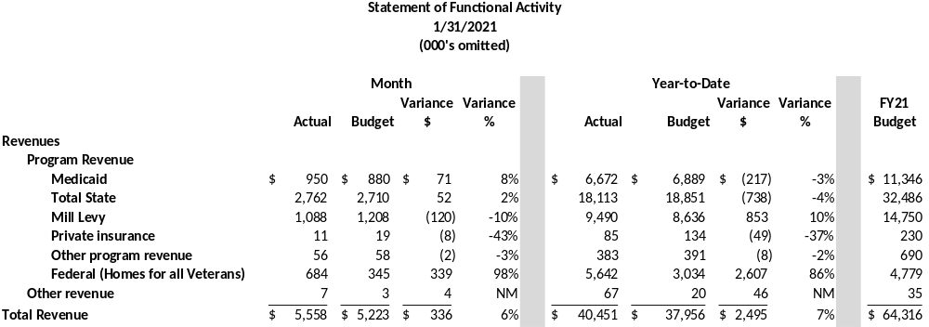
Year-to-Date Financials

Slide 23
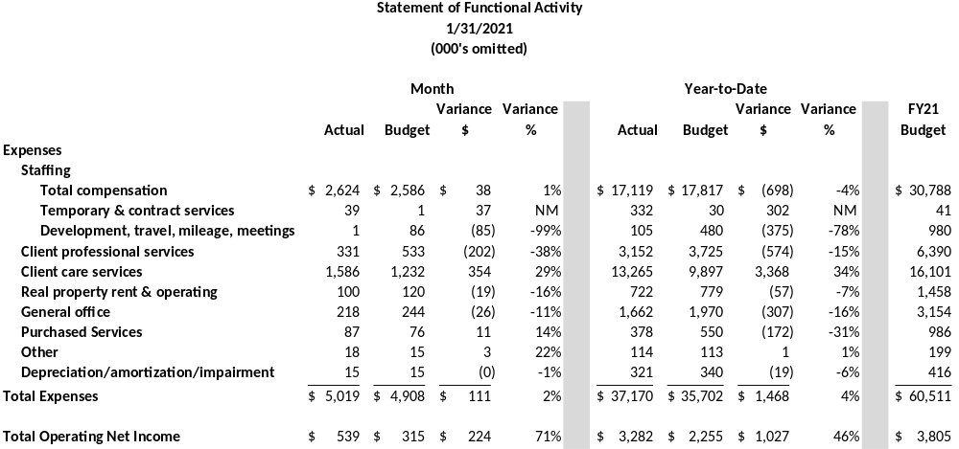
Year-to-Date Financials

Slide 24
Financial Statements
Proposed Board Resolution:
The Board accepts the financial statements for the seven months ending January 31, 2021.

Slide 25

Adjournment

